Slide 1
Capstone Project
Team 2 : Loan Default Prediction
Suraj Pandey

Slide 2

Let’s Catch The Defaulters
Defining problem statement
EDA and feature engineering
Feature Selection
Preparing dataset for modeling
Model Validation and Selection

Slide 3

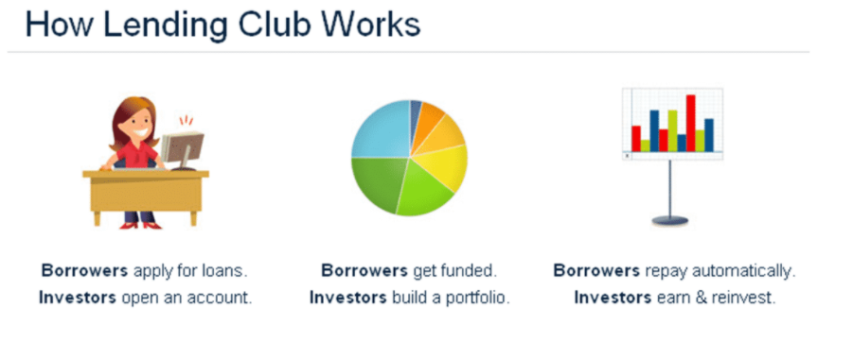
The Dilemma
Lending Club is the world’s largest online marketplace connecting borrowers and investors. An inevitable outcome of lending is default by borrowers. The idea of this tutorial is to create a predictive model that identifies applicants who are relatively risky for a loan. In order to accomplish this, I organized the whole series into four parts as follows:

Slide 4
Data Pipeline
Data processing-1: In this first part we’ve removed unnecessary features.
There were nearly Many columns with all Null values.
Data processing-2: In this part, we manually go through each features selected from part 1. This is the most time-consuming part, but worth it for a better model.
EDA: In in this part, we do some exploratory data analysis (EDA) on the features selected in part-1 and 2.
Create a model: Finally, In this last but not the last part, we create models. Creating a model is also not an easy task. It’s also an iterative process. we show how to start with a with a simple model, then slowly add complexity for better performance.

Slide 5
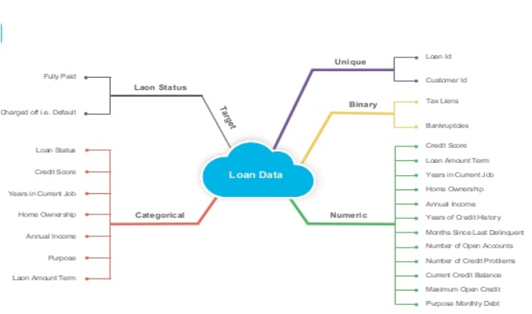
Data Summary

Slide 6
Data Summary
loan_amnt: The amount the borrower promises to repay, as set forth in the loan contract.The loan amount may exceed the original amount requested by the borrower if he or she elects to include points and other upfront costs in the loan.
Purpose:The purpose of the loan is used by the lender to make decisions on the risk and may even impact the interest rate that is offered. For example, if an applicant is refinancing a mortgage after having taken some cash out, the lender might consider that an increase in risk and increase the interest rate that is offered or add additional conditions. Loan purpose is important to the process of obtaining mortgages or business loans that are connected with specific types of business activities.

Slide 7
Data Summary
Dti: Your debt-to-income ratio is all your monthly debt payments divided by your gross monthly income. This number is one way lenders measure your ability to manage the monthly payments to repay the money you plan to borrow.
Fico_range: A FICO score is a credit score created by the Fair Isaac Corporation (FICO).¹﻿ Lenders use borrowers’ FICO scores along with other details on borrowers’ credit reports to assess credit risk and determine whether to extend credit. FICO scores take into account data in five areas to determine creditworthiness: payment history, current level of indebtedness, types of credit used, length of credit history, and new credit accounts.

Slide 8
Data Summary
Delinq_amnt : Delinquent describes something or someone who fails to accomplish that which is required by law, duty, or contractual agreement, such as the failure to make a required payment or perform a particular action.
Int_rate: An interest rate is defined as the proportion of an amount loaned which a lender charges as interest to the borrower, normally expressed as an annual percentage. It is the rate a bank or other lender charges to borrow its money, or the rate a bank pays its savers for keeping money in an account.

Slide 9
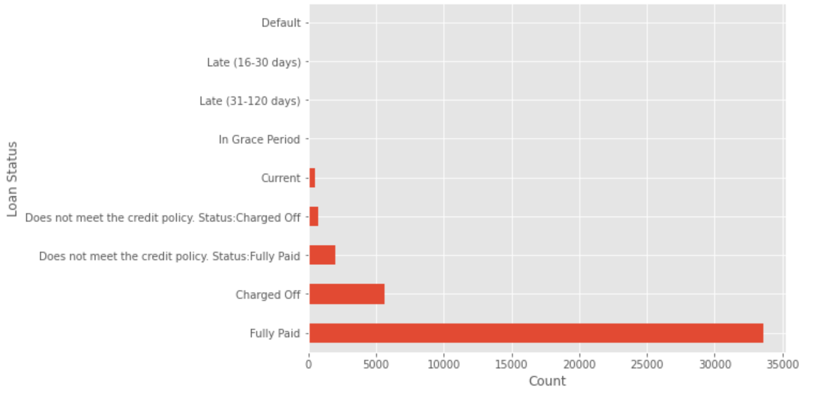
Define Dependent Variable

Slide 10

Define Dependent Variable
Fully Paid->Loan has been fully paid off.
Charged off->Loan for which there is no longer a reasonable expectation of further payments.
Does not meet the credit policy. Status:Fully Paid--> While the loan was paid off, the loan application today would no longer meet the credit policy and wouldn't be approved on to the marketplace.
Does not meet the credit policy. Status:charged off->While the loan was charged off, the loan application today would no longer meet the credit policy and wouldn't be approved on to the marketplace.
Current->Loan is up to date on current payments.,
In Grace period->The loan is past due but still in the grace period of 15 days.
Late(30-120)->Loan hasn't been paid in 31 to 120 days (late on the current payment).
Late(16-30)->Loan hasn't been paid in 16 to 30 days (late on the current payment).
Default->Loan is defaulted on and no payment has been made for more than 121 days.

Slide 11
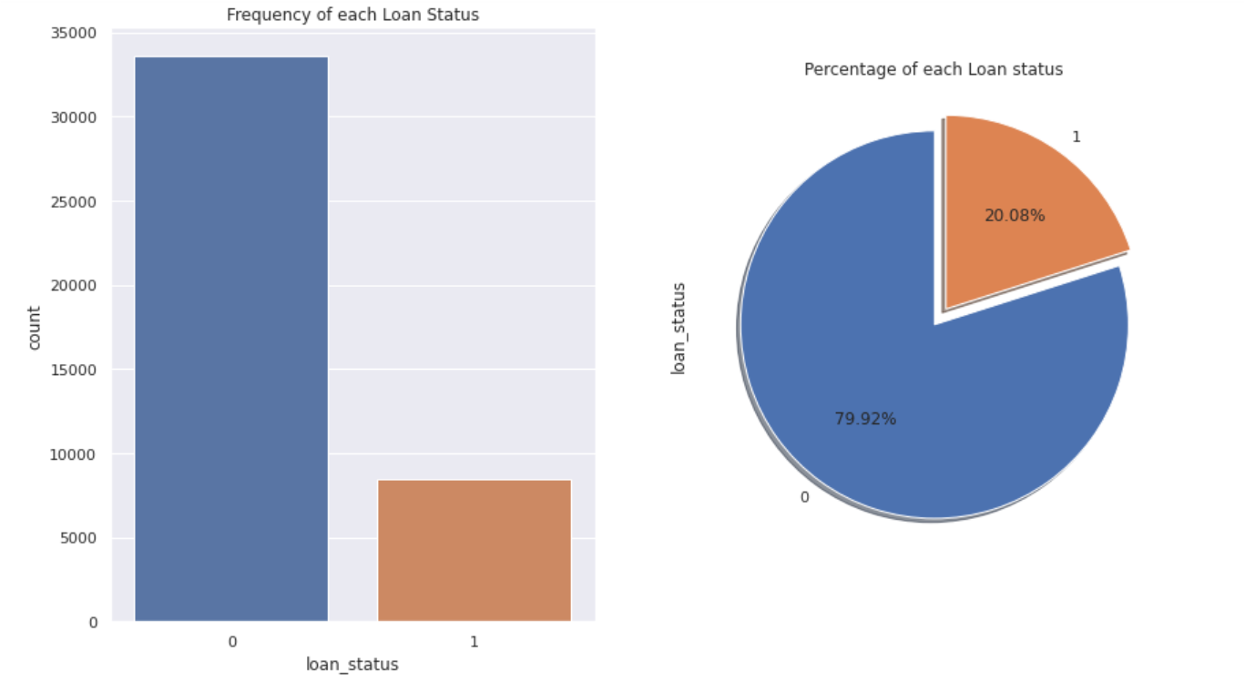
Define Dependent Variable

Slide 12
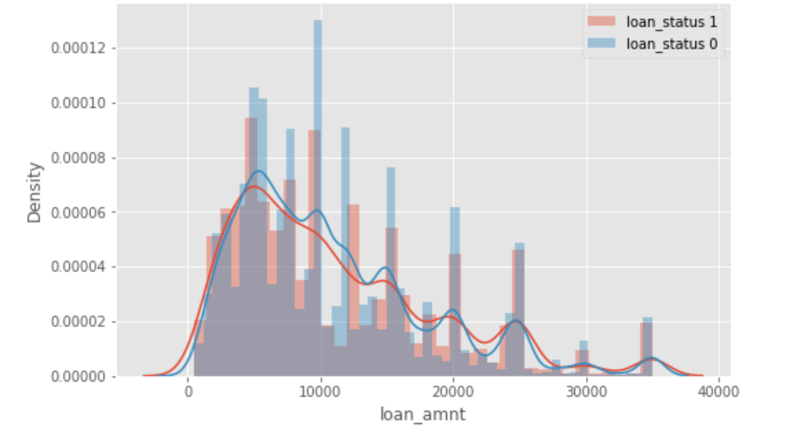
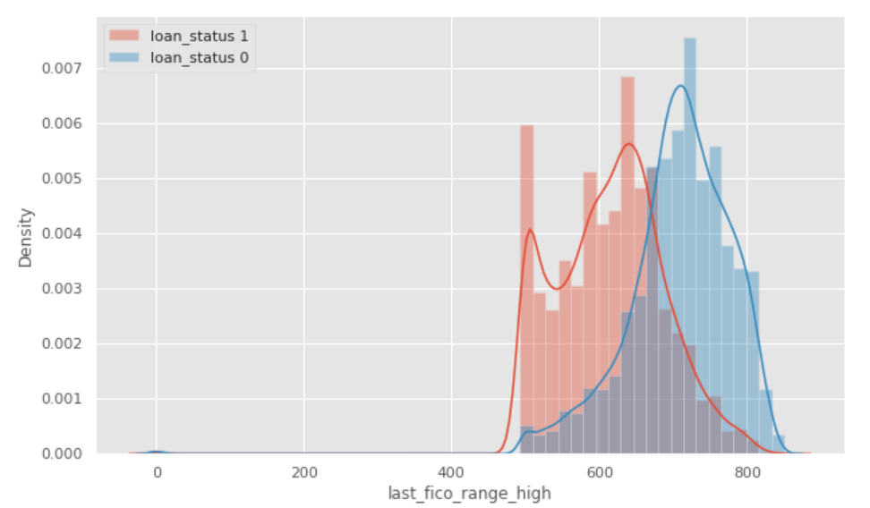
EDA

Slide 13
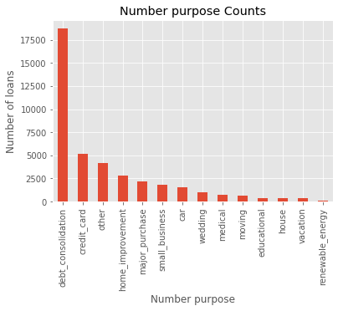
EDA Cont..

Slide 14
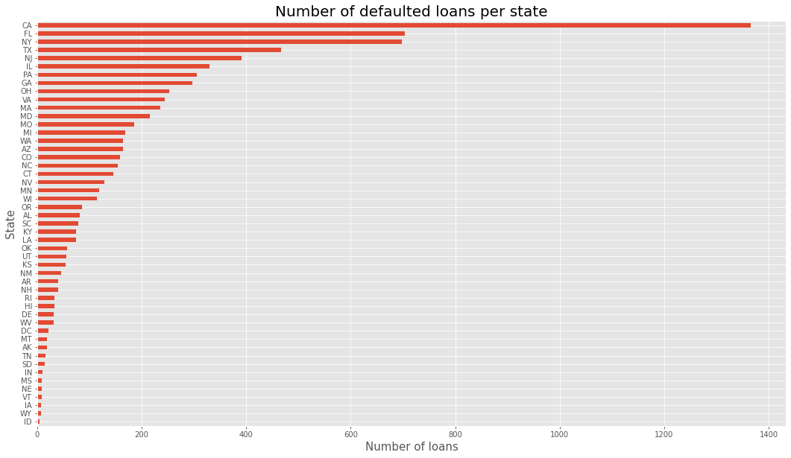

EDA cont..

Slide 15
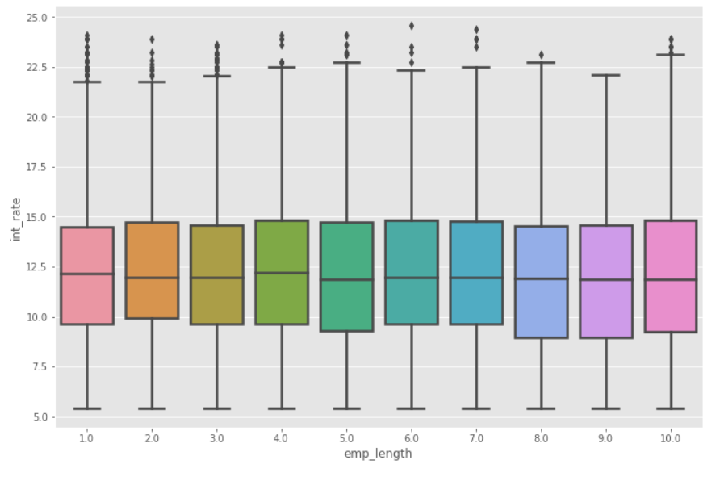
EDA cont..

Slide 16
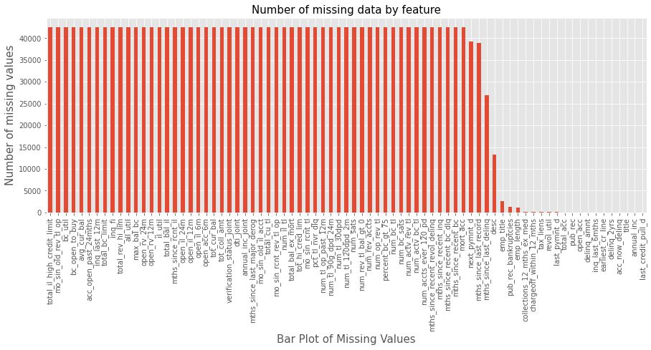
EDA cont..

Slide 17
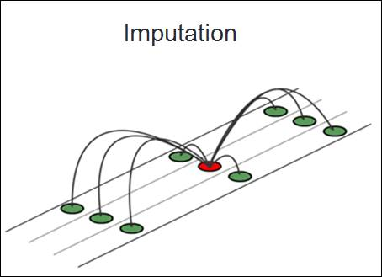
EDA cont.. (Implement KNN Imputer for missing value)
Imputation for completing missing values using
k-Nearest Neighbors.Each sample’s missing values
are imputed using the mean value from n_neighbors
nearest neighbors found in the training set. Two
samples are close if the features that
neither is missing are close.
The KNN Imputer class provides imputation
for filling in missing values using the k-Nearest
Neighbors approach. By default, a euclidean distance
metric that supports missing values,
nan_euclidean_distances, is used to find the
nearest neighbors. Each missing feature is imputed
using values from n_neighbors nearest neighbors t
hat have a value for the feature. The feature
of the neighbors are averaged uniformly or weighted
by distance to each neighbor.

Slide 18
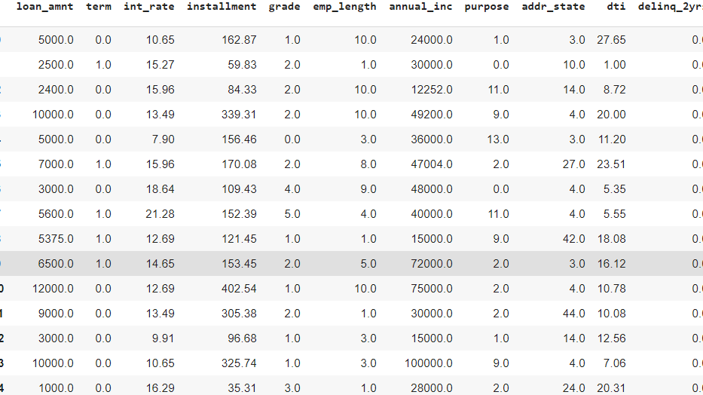
Preparing dataset for modeling
Task:-
Train Set:-
Test set:-
Response:-

Slide 19
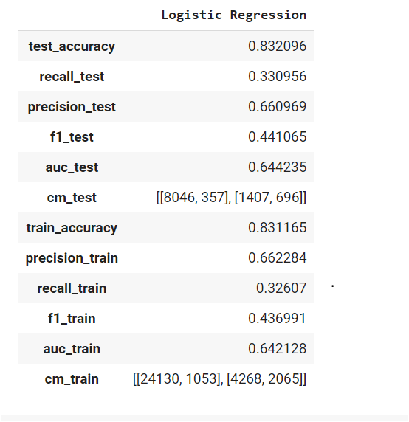
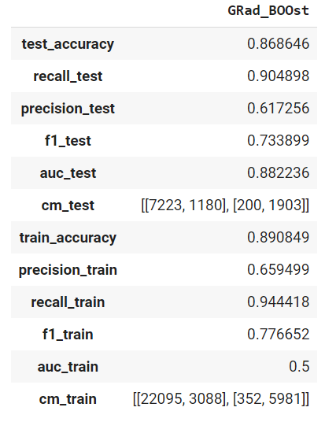
Model Validation & Selection(Baseline Model)

Slide 20
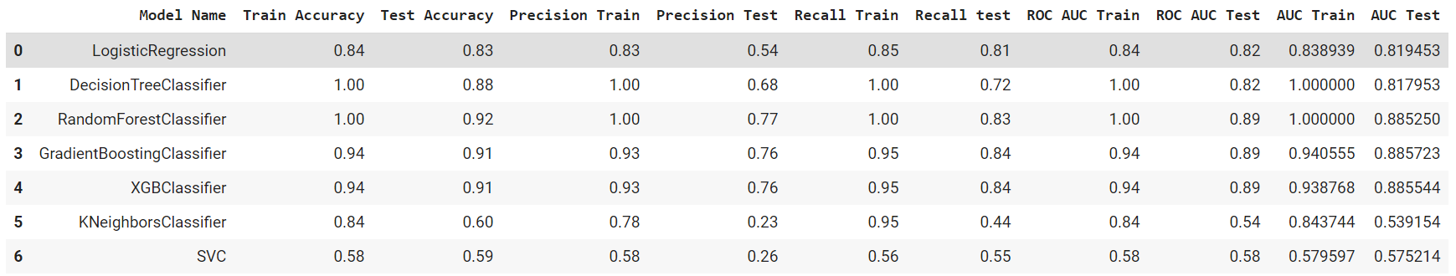
Model Validation & Selection(SMOTE)

Slide 21
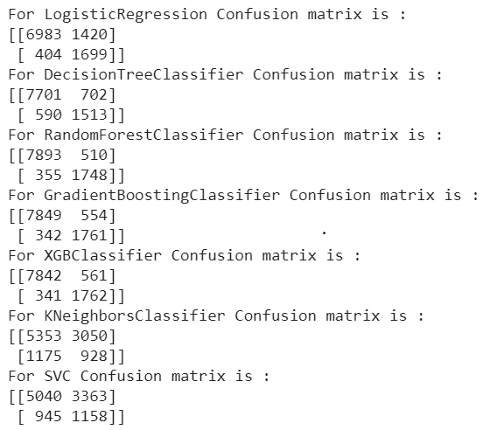
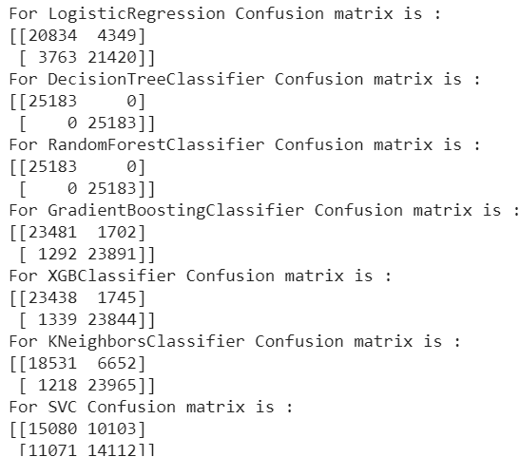
Model Validation & Selection(Classification Matrix)
Test Data
Train Data

Slide 22
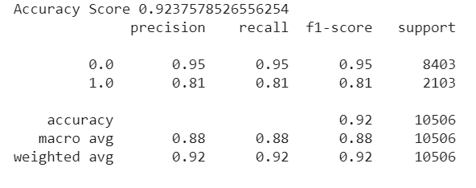
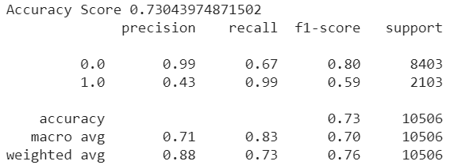
Model Validation & Selection(Hyperparameter tuned)
Random Forest Classifier
XG Boost Classifier

Slide 23

Model Validation & Selection(continued)
Observation 1: As seen in the table above, DT classifier gives us a better precision value whereas Random Forest classifier is lagging behind in terms of precision,but from the business perspective we are looking for a better recall value, which is given to us by Random Forest classifier.
Observation 2: Gaussian NB has performed poorly in terms of precision and AUC value, whereas we see that DT Classifier,RT Classifier,GB Classifier & XBG Classifier have performed equally good in terms of F-1 Score and Test accuracy.

Slide 24
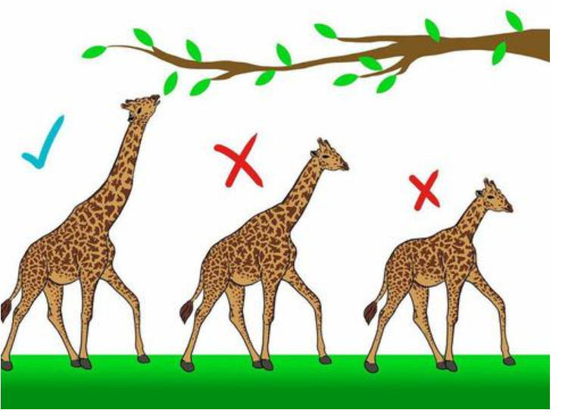
Model Validation & Selection(continued)
Observation 3: From the above observation we have come to the conclusion that we would choose our model from RF Classifier,GB Classifier or XGB Classifier.
Although, we see DT Classifier also giving great results but that may lead of overfitting of the data.

Slide 25

Model Validation & Selection(continued)
We had chosen XG Boost Classifier for our prediction and the best hyperparameters obtained are as below.
Best hyperparameters:
colsample_bylevel=1,
colsample_bynode=1
colsample_bytree=0.9,eta=0.3,gamma=0,
learning_rate=0.1, max_delta_step=0, max_depth=5,
min_child_weight=1, missing=None, n_estimators=100, n_jobs=1,nthread=4,num_boost_round=10
objective='binary:logistic'
random_state=0, reg_alpha=0, reg_lambda=1,scale_pos_weight=90

Slide 26
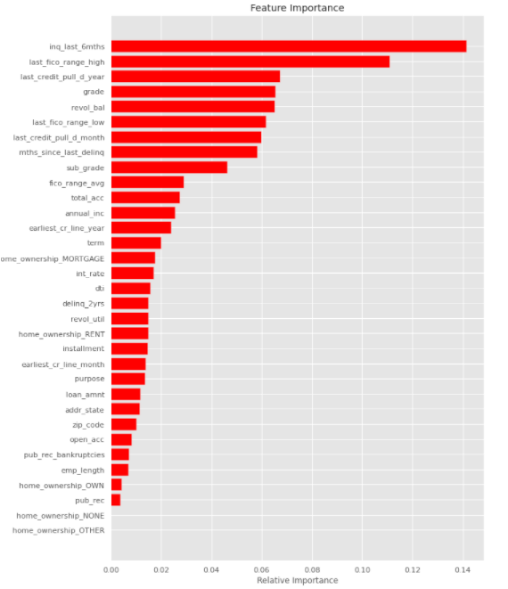
Model Validation & Selection(continued)

Slide 27
Challenges
Huge chunk of data was to be handled keeping in mind not to miss anything which is even of little relevance.
Feature selection was quite a challenge as our dataset had many futuristic features which had no relevance for initial detection of loan defaulter.

Slide 28
Futuristic Features
total_pymnt:- Payments received to date for total amount funded.
total_pymnt_inv:-Payments received on date for portion of total amount funded by investors.
total_rec_prncp:-Principal received to date.
total_rec_int:-Interest received to date.
total_rec_late_fee:-Late fees received to date.
recoveries:-post charge off gross recovery.
collection_recovery_fee:-post charge off collection fee.
last_pymnt_d:-Last month payment was received.
last_pymnt_amnt:-Last total payment amount received.
funded_amnt:-The total amount committed to that loan at that point in time.
funded_amnt_inv:-The total amount committed by investors for that loan at that time.

Slide 29
Q & A

